Slide 1
INTERNET OF THINGS
Maurici Abad
Agustin D’acunto
Mohamed Chait
Meir Carlos Mouyal Amselem

Slide 2

What is the Internet of Things (IoT)?

Slide 3
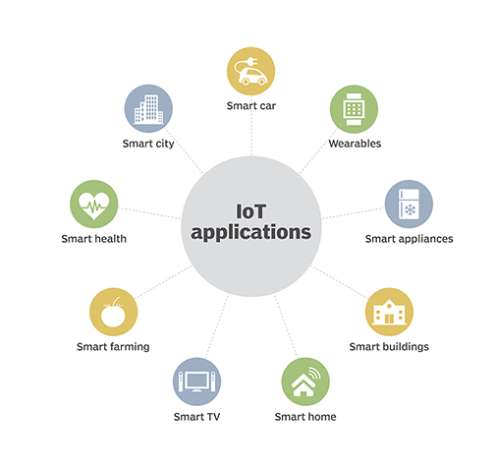

Slide 4
HISTORY OF IoT

Slide 5
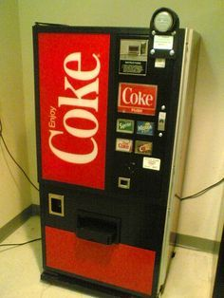
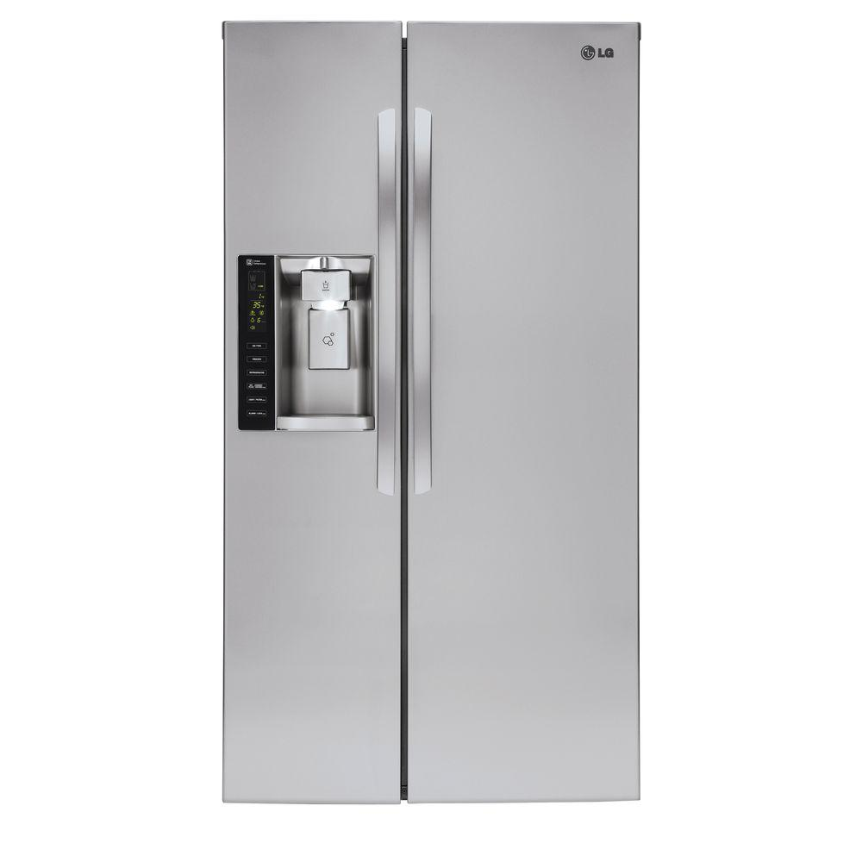
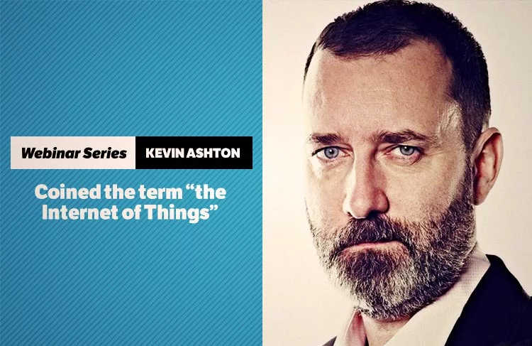
First devices
1999

Slide 6
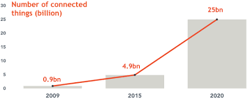
Future of IoT: Garner forecast

Slide 7
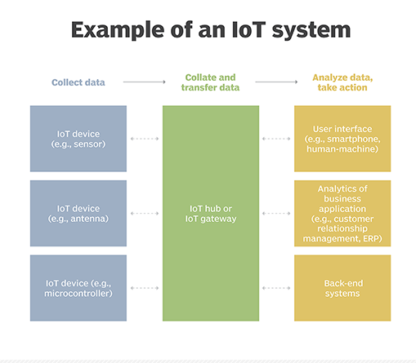
How does it work?

Slide 8
EXAMPLES OF BREACHES
&
POSSIBLE THREATS
Notes:
talk about examples of unsecure IoT
Smart fiungerprint padlock (smart loker)
explan how it works
proces
can be open with screwdriver
you can use bt to unlock it
clous services that the app talks to, to find locks
Wifi kettle
connects to wifi
conect with the kattle
fint the chip data sheet
get the pasword
it’s fixed
My friend cayla: interactive speaking kid’s toy
it has no bt pin
anyone in range can listen and talk with kids
Wireles home security camera
when you acces the cloud services there was a bug, you could view other’s camera
the issue was fixed in a week, but it was iun the market for 9montsh
Wired camera
3thre handred thausand cameras were used to do an DDoS attak to twitter ans facebook
Termostat
the problem is thay every one can be used all together to turn of city lights
cayla again
it was prohivited in some countries
but laws are slow
who to be safe
usestrong paswords
Put IoT in a separate network
Don’t buy IoT unless vendors prove it’s secure

Slide 9

Tapplock one+
Easily disassembled with a screwdriver
Pen Test Partners discovered
Its digital key is its bluetooth address
Pen Test Partners discovered
Its location can be discovered with the app Cloud Service

Slide 10
Tapplock one+ - THREATS
Steal your belongings

Slide 11
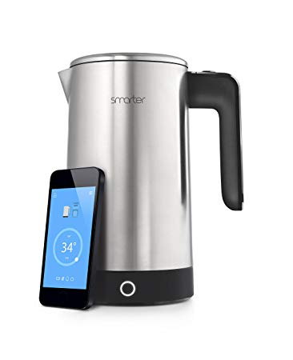
Smarter iKettle 1st gen
$ telnet 169.254.1.1
AT+ command shell
Password:000000
Login successfully
Type ‘exit’ for quit
HED>AT+SSID
+OK=”Orange-A9EA”
HED>AT+KEY
+OK=1.0.”si38r8tg89cm024”
HED>_
Notes:
it creates a network, so you connect to it

Slide 12
Smarter iKettle 1st gen - THREATS
Access all traffic of your Wi-Fi
Redirects to phishing pages
Steal bandwidth
Next generations are safer

Slide 13
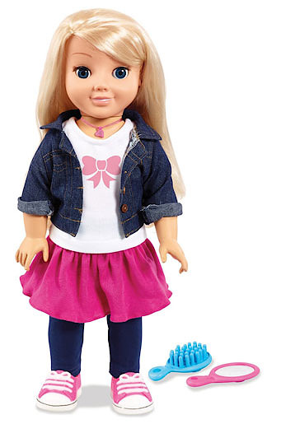
My friend Cayla doll
Released on 2014
It won Most Wanted Dolls of 2015 from TTPM

Slide 14
My friend Cayla doll
Released on 2014
It won Most Wanted Dolls of 2015 from TTPM
PIN

Slide 15
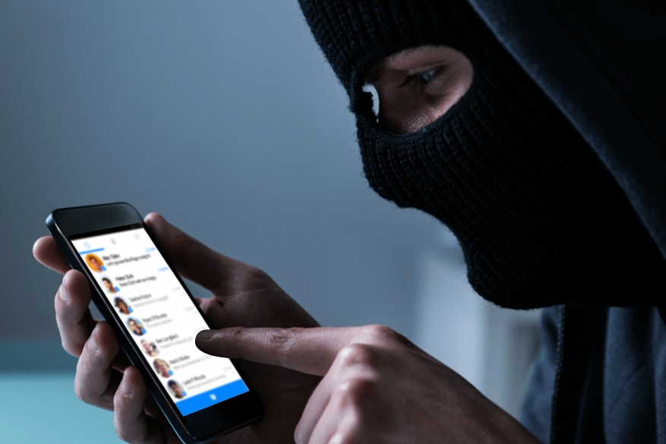
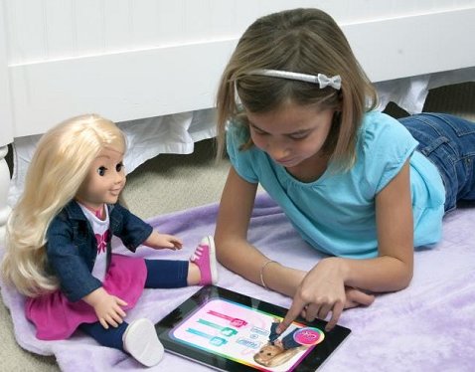
My friend Cayla doll - THREATS
< 80m

Slide 16

My friend Cayla doll - THREADS
< 80m

Slide 17

Smart home security cameras
Google dorks & Public IP Cameras
intitle:”sony network camera snc-p1?
intitle:snc-z20 inurl:home/
http://www.insecam.org/en/view/789630/
Mirai malware a IoT BotNet

Slide 18
Smart home security cameras - THREADS
DDoS attacks
Know when you are not at home
Infect other IoT devices
If a thermostat is infected the hacker may cause a power cut

Slide 19
SECURITY IN IoT

Slide 20
Security challenges
Not building security from start
Hard-coded and default passwords
Not enough resources for advanced security
Security updates
Lack of standards

Slide 21
Security measures
Implement security on design phase
Update security software
Not hard-coded passwords, and changing
API Security
Network Security
Educate customers

Slide 22
CONCLUSION

Slide 23
Conclusion
IoT is not secure

Slide 24
THANK YOU

